Slide 1



Identifying and Quantifying UAV Camera Limitations: Case Study using DJI XTR Camera
Presenter:
Aswin Balasubramaniam
University of Cincinnati Infrastructure Institute

Slide 2
Presentation Overview
Acknowledgments:
Ohio Department of Transportation
University of Cincinnati Professors/Staff:
Dr. Arthur Helmicki
Dr. Victor Hunt
Dr. Mehdi Norouzi
Dr. Kelly Cohen
Dr. Manish Kumar
Bryan Brown
Introduction
Applications of Photogrammetry in Inspections
Construction Monitoring
Bridge Inspection
Facility Inspection
Thermal Inspection
Case study: DJI XTR Camera
Theory
Case Study Overview
Results and Analysis
Conclusion
References
2

Slide 3






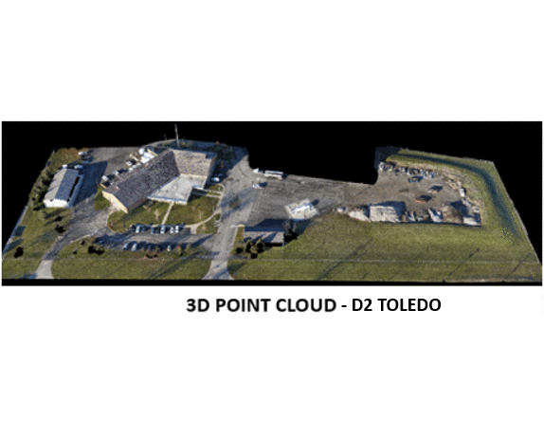


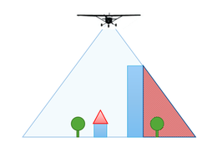

Introduction
CAPTURE
PROCESS
ANALYZE
Professional photogrammetry software for drone-based mapping
UCII Common Operating Platform
UCII’s online solution to process 3D model built using Pix4D platform
3
Figure 1: UCII Workflow
3
Notes:
To augment inspections of structures a user can use UAVs to capture images of the structure in a certain pattern with front and side overlaps and use Pix4D (commercial 3D modelling software) generated outputs to inspect it in detail.

Slide 4
Introduction
Flight planning requirements:
Shorter flight times.
Capture images with the required overlaps.
Know camera parameters and their limits.
If not known captured images might not have the required overlaps between them.
This study reviews DJI XTR limits, and its effect on GSD and overlap between images.
CAPTURE
4
Notes:
Flight planning applications like DJI GS Pro allows users to automate this image capture process, by creating automated flight plans based on users inputs of flight parameters and camera settings.
If a camera’s limitations are unknown to a user, images are captured with insufficient overlaps which in turn produce errors in Pix4D.
The study presented in this paper reviews the limitation of the DJI XTR thermal camera, with emphasis on its requirement of higher triggering interval when used under equal timed triggering mode of capture and thus its effects on GSD and overlap between images.

Slide 5
Applications of Photogrammetry in Inspections
5

Slide 6
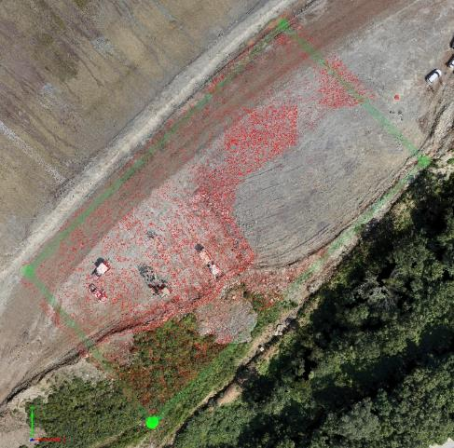
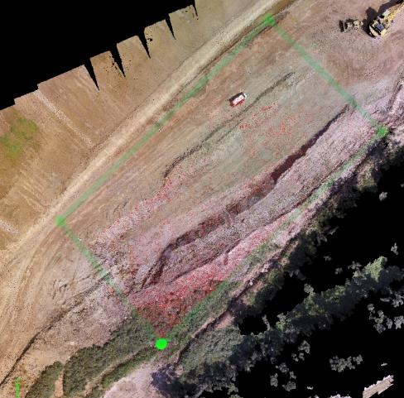
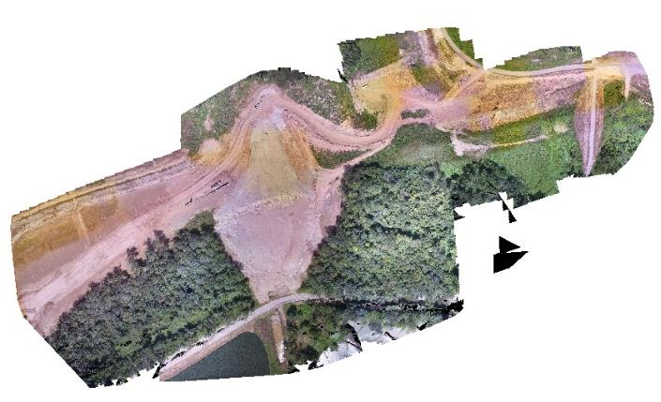
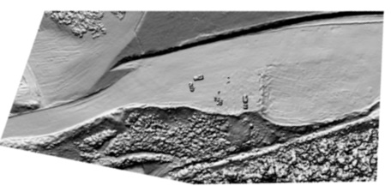
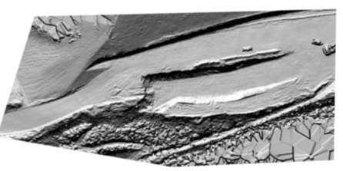
Applications of Photogrammetry in Inspections
Construction Monitoring
Monitor the quality, accuracy, and progress of a construction project using 3D models.
Measure land fill and cut volumes.
Measure large surface areas of roads, and pre-splits.
BEFORE
Aug 24
AFTER
Aug 26
BEFORE
Aug 26
BEFORE
Aug 24
AFTER
Sep 21
AFTER
Aug 26
6
Figure 2: D10 SR266 Construction Project

Slide 7
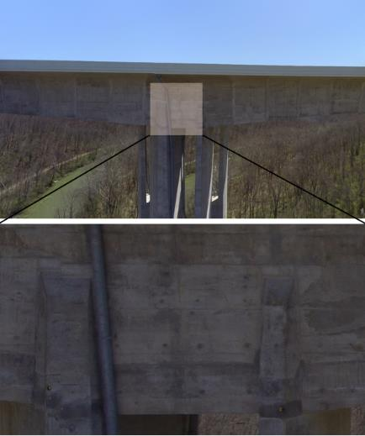
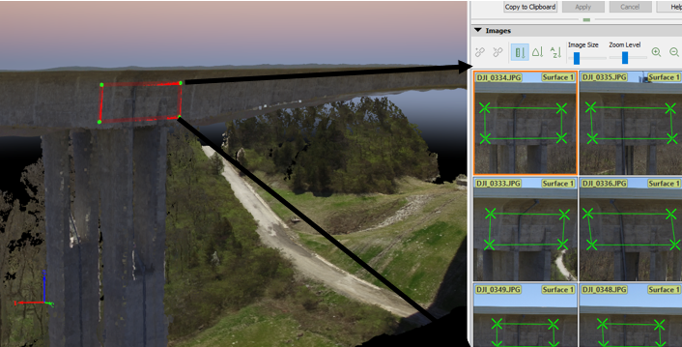
Applications of Photogrammetry in Inspections
Bridge Inspection
Aid in snooper-bridge type inspections.
Detect and identify crack widths on bridge facades.
Detect and identify delamination on road surfaces.
Figure 3: Jeremiah Morrow Bridge Inspection
7

Slide 8
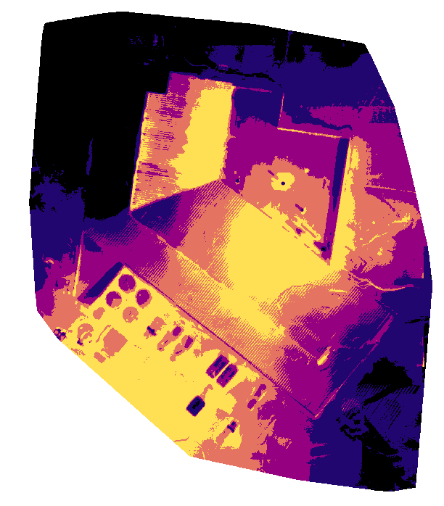
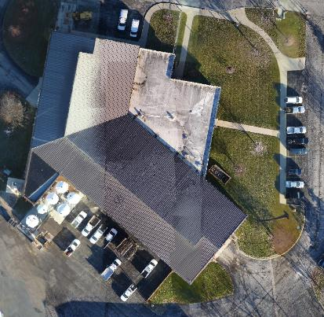
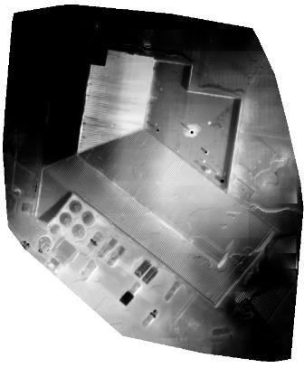
Applications of Photogrammetry in Inspections
Facilities Inspection
Aerial Visual Inspections:
Dirt/Debris Accumulation
Cracking, tears, holes or scratches
Fungus/moss growth
Exterior structure condition
Building heat loss inspection
Thermal Map of the Northwood Garage
Optical Orthomosaic of the Northwood Garage
Thermal Map of the Northwood Garage w/o indices
8
Figure 4: Northwood Garage Toledo Facility Inspection

Slide 9
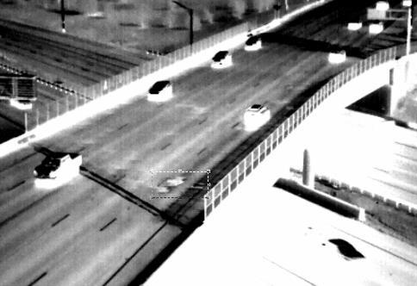
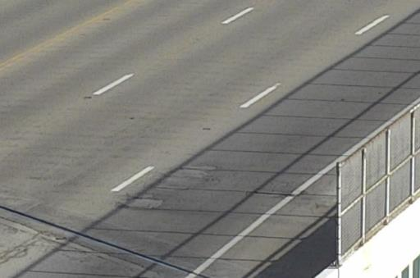
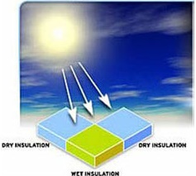
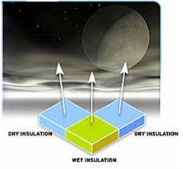
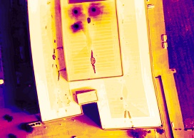
Applications of Photogrammetry in Inspections
Thermal Inspection
Roof Moisture and Wearing Surface Inspections
Detecting Delamination on Road Surface and Bridge Decks
Detect and document trapped moisture and wearing on flat roofs.
Water can enter through defect in waterproofing layer due to deterioration, cuts, and tears causing the insulation to trap moisture.
Buildings would then experience energy losses due to wet
insulation.
Document temperature variations on bridge decks, and road surfaces.
Delaminated areas heat up faster during the day, and cools down quicker during the night, relative to intact concrete. [3]
Source: www.infraredroofinspectors.com
Figure 6: Thermal Deck/Road Surface Inspection
Figure 5: Thermal Roof Inspection
9

Slide 10
Case Study: DJI XTR Thermal Camera
10

Slide 11
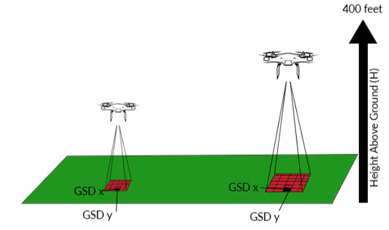
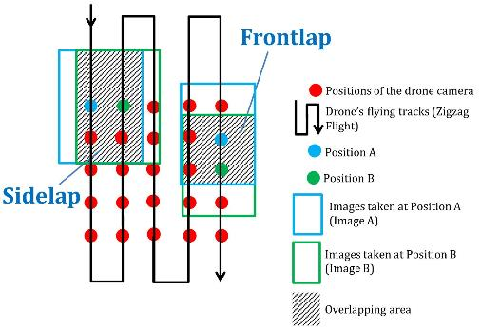
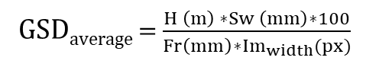
Key Terminologies
Case Study: DJI XTR Thermal Camera
Ground Sampling Distance (GSD): It is the distance covered by each pixel in the image.
GSD_{average} = $\frac{H \left(m\right) ∗Sw \left(mm\right)∗100}{Fr\left(mm\right)∗{Im}_{width}(px)}$
H:- Height of flight (m)
Sw:- Camera Sensor Width (mm)
Fr:- Real focal length (mm)
Im_{width}:- Width of Image (px)
Figure 7: GSD Infograph
Source: Drone Deploy
Overlap Percentage: It is the percentage of overlap between images i.e. the amount by which one image includes the area covered by the next image.
Figure 8: Overlap Infograph
Source: www.nrcan.gc.ca
11

Slide 12
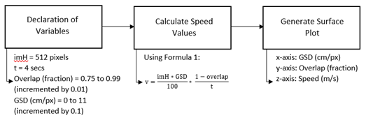
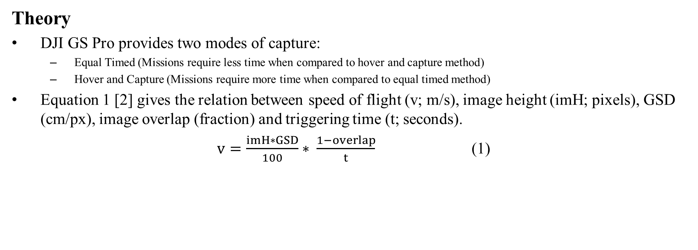
Case Study: DJI XTR Thermal Camera
Theory
DJI GS Pro provides two modes of capture:
Equal Timed (Missions require less time when compared to hover and capture method)
Hover and Capture (Missions require more time when compared to equal timed method)
Equation 1 [2] gives the relation between speed of flight (v; m/s), image height (imH; pixels), GSD (cm/px), image overlap (fraction) and triggering time (t; seconds).
$v=\frac{imH∗GSD}{100}∗ \frac{1−overlap}{t}$ (1)
Figure 9: Flowchart of the process followed to generate the characteristic surface plot
12

Slide 13
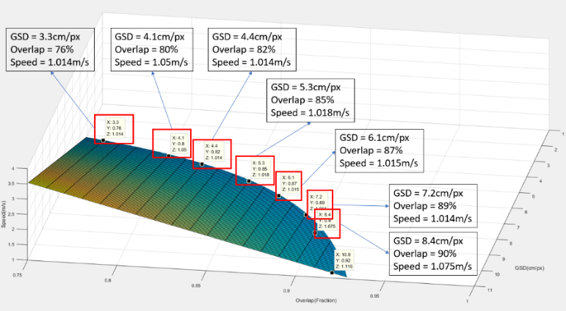
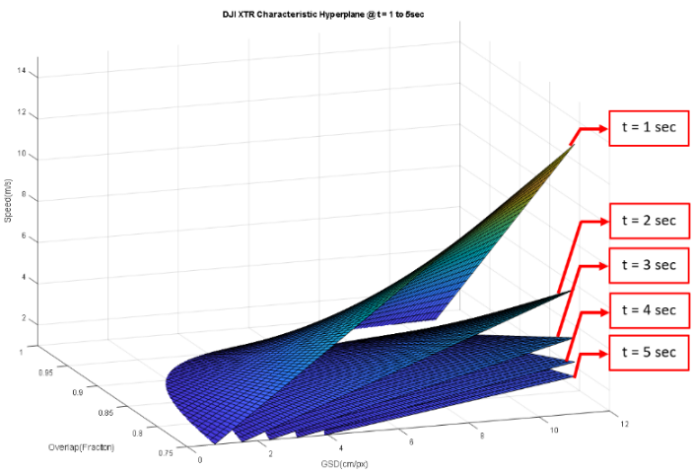
Theory
Figure 10: DJI XTR characteristic surface plot for triggering interval of 4sec
Figure 11: DJI XTR characteristic 3D surface plots for triggering interval of 1-5sec
13

Slide 14
Case Study: DJI XTR Thermal Camera
XTR Surface Plot @ t = 5sec
XTR Surface Plot @ t = 4sec
Case Study Overview
Aim: Understand the effect of varying triggering intervals on the image dataset captured using DJI XTR for a set of flight parameters selected from the surface plots (Figure 12).
100%
14 m/s
100%
14 m/s
Overlap (%)
Speed (m/s)
Overlap (%)
Speed (m/s)
75%
2 m/s
75%
2 m/s
XTR Surface Plot @ t = 3sec
2 cm/px
GSD (cm/px)
12 cm/px
2 cm/px
GSD (cm/px)
12 cm/px
XTR Surface Plot @ t = 2sec
XTR Surface Plot @ t = 1sec
100%
14 m/s
100%
14 m/s
100%
14 m/s
Overlap (%)
Speed (m/s)
Overlap (%)
Overlap (%)
Speed (m/s)
Speed (m/s)
75%
2 m/s
75%
2 m/s
75%
2 m/s
2 cm/px
GSD (cm/px)
12 cm/px
2 cm/px
GSD (cm/px)
12 cm/px
2 cm/px
GSD (cm/px)
12 cm/px
Figure 12: DJI XTR characteristic surface plot for t = 5 to 1 seconds
14

Slide 15
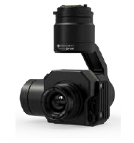
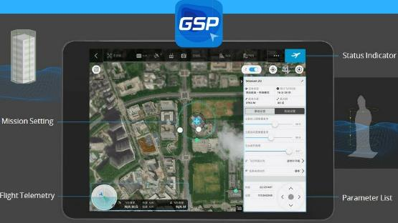
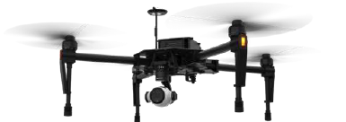
Case Study: DJI XTR Thermal Camera
Case Study Overview
Equipment:
DJI Matrice 100
DJI 19mm XTR Thermal Camera (0.33MP) (640x512)
DJI GS Pro Flight Planning Application
DJI Matrice 100
DJI XTR Camera
DJI GS Pro Application
Source: DJI
Source: DJI
Source: DJI
Figure 13: Case Study Equipment
15

Slide 16
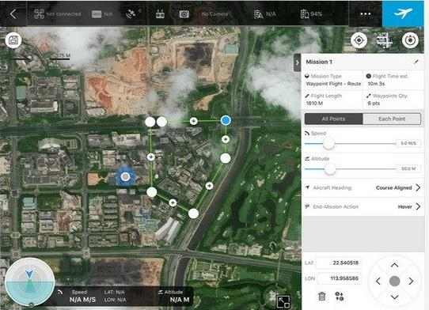
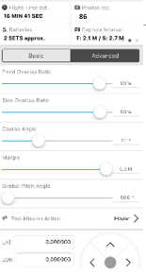
Case Study: DJI XTR Thermal Camera
Case Study Overview
Experiment:
Twenty different flight plans were generated using the flight parameters on the surface plots in Figure 12, and the DJI GS Pro application.
Flight parameters that lie on the edge, and the center of the plots were selected.
The pattern of image capture for varying triggering interval was observed and analyzed.
The number of images captured was compared with the DJI GS Pro estimated number of images.
Estimated Photos: 86
Figure 14: DJI GS Pro Flight Plan
16

Slide 17
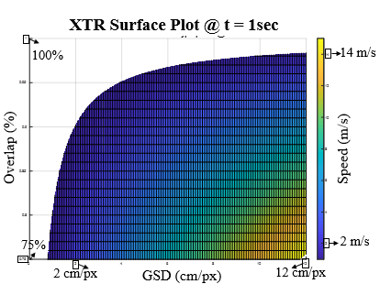
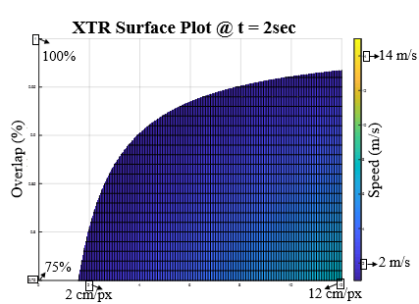
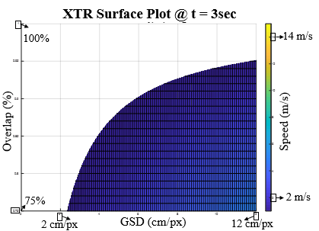
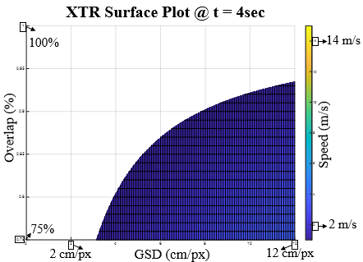
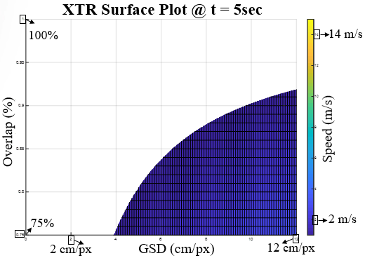
Case Study: DJI XTR Thermal Camera
Results and Analysis
t = 1 sec
t = 2 sec
t = 3 sec
t = 4 sec
t = 5 sec
Figure 12: DJI XTR characteristic surface plot for t = 5 to 1 seconds
Decrease in area of plots indicate indicates a decrease in the number of flight parameter sets available
17

Slide 18
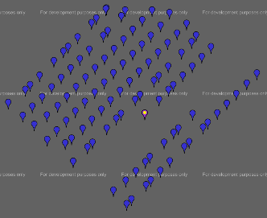
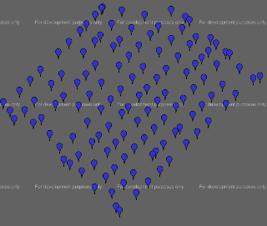
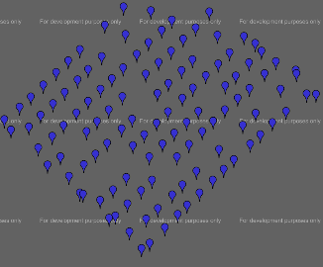
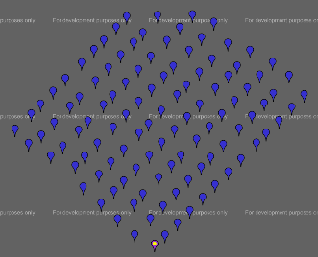
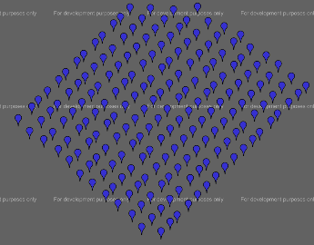
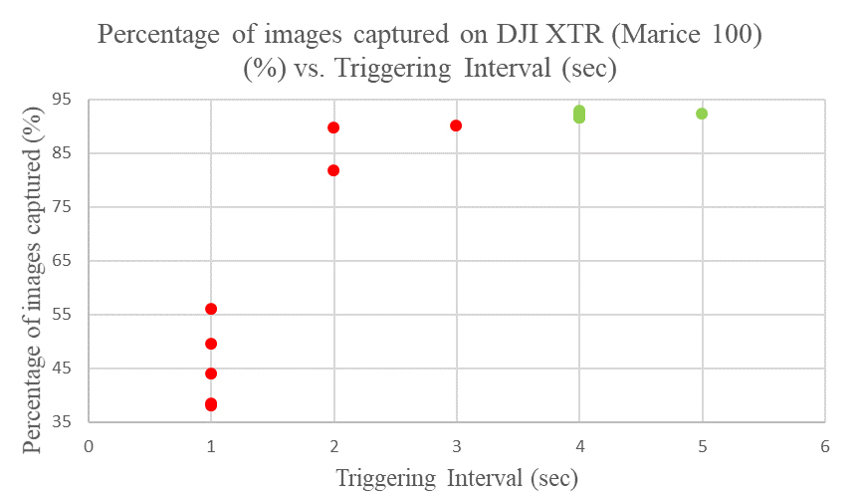
Case Study: DJI XTR Thermal Camera
Results and Analysis
t = 1 sec
t = 2 sec
t = 3 sec
t = 4 sec
t = 5 sec
Figure 15: GeoSetter screenshots of image dataset obtained for triggering intervals 1, 2, 3, 4, and 5 seconds (left to right)
Saturates to 93% at t= 4
Figure 16: Graph of percentage of images captured on DJI XTR (%) vs. Triggering Interval (sec)
18

Slide 19
Case Study: DJI XTR Thermal Camera
Results and Analysis
From the results generated it can be seen that the camera requires at least 4 seconds to capture images as per requirements.
Figure 5 shows the issues in image capture when the triggering interval is set below 4 seconds. It can be seen that the overlap becomes inconsistent and rows of images go missing when the correct triggering interval is not set.
The plot shown in Figure 6 shows that at the triggering interval of 4seconds the percentage of images captured saturates at 93%.
The data obtained confirms the hypothesis stated where the flight parameters on and below the 4-second surface plot generates desired data sets and flight parameters used from the surface plots above the 4 second surface plot generated undesirable data sets.
For t = 4sec at 85% overlap the best GSD = 5.3cm/px
Figure 10: Characteristic surface plot for triggering interval of 4sec
19

Slide 20
Case Study: DJI XTR Thermal Camera
Conclusion
The method applied in this study is one of many methods that can be used to benchmark and analyze the limits of camera systems.
When the surface plots at varying triggering intervals was compared, it was observed that the set of flight parameters reduce as the triggering interval increases.
Through the experiment conducted the following was concluded:
Under equal timed mode of capture, DJI XTR required a minimum triggering interval of 4 seconds to capture images as required.
The percentage of images captured saturated at 93% at for t ≥ 4sec.
For an image overlap of 85% the best GSD obtainable is 5.3cm/px
The results from this study provided us the information to improve existing work and aided in designing efficient flight plans to obtain high-resolution of thermal images of the structure being mapped.
20
Notes:
Similar analysis method can be applied and extended to various other visual/thermal cameras.
With this study, a user can efficiently use their available camera systems to capture images with the necessary GSD and overlaps to augment their inspection process and improve their core inspection procedures

Slide 21
References
[1] M. Vollmer and K.-P. Möllmann, Infrared ThermalImaging Fundamentals, Research and Applications, no. 2003. 2006.
[2] “Offline Getting Started and Manual (pdf) – Support.” [Online]. Available: https://support.pix4d.com/hc/en-us/articles/204272989-Offline- Getting-Started-and-Manual-pdf-. [Accessed: 07-Mar-2018].
[3] G. Washer, R. Fenwick, S. Nelson, and R. Rumbayan, “Guidelines for Thermographic Inspection of Concrete Bridge Components in Shaded Conditions,” Transportation Research Record: Journal of the Transportation Research Board, vol. 2360, no. 1, pp. 1–14, 2013.
[4] K. NONAMI, “Prospect and Recent Research & Development for Civil Use Autonomous Unmanned Aircraft as UAV and MAV,” J. Syst. Des. Dyn., vol. 1, no. 2, pp. 120–128, 2007.
[5] Maldauge X, “Introduction to NDT by Active Infrared Thermography,” Campylobacter Ecol. Evol., pp. 313–320, 2014.
[6] H. Jones and X. Sirault, “Scaling of Thermal Images at Different Spatial Resolution: The Mixed Pixel Problem,” Agronomy, vol. 4, no. 3, pp. 380–396, 2014.
[7] FLIR, “Datasheet FLIR Tau2,” 2016.
[8] DJI, “Zenmuse XT User Manual,” pp. 1–17, 2016.
[9] D. Welbourne, “A method for surveying diurnal terrestrial reptiles with passive infrared automatically triggered cameras,” Herpetol. Rev., vol. 44, no. 2, pp. 247–250, 2013.
[10] T. M. Kwon, “Atmospheric Visibility Measurements Using Video Cameras : Relative Visibility,” no. 2, 2004.
[1] J. L. Lerma, M. Cabrelles, and C. Portalés, “Multitemporal thermal analysis to detect moisture on a building faade,” Constr. Build. Mater., vol. 25, no. 5, pp. 2190–2197, 2011.
[12] E. Grinzato, P. G. Bison, and S. Marinetti, “Monitoring of ancient buildings by the thermal method,” J. Cult. Herit., vol. 3, no. 1, pp. 21–29, 2002.
21

Slide 22
Questions?
22

